Slide 1
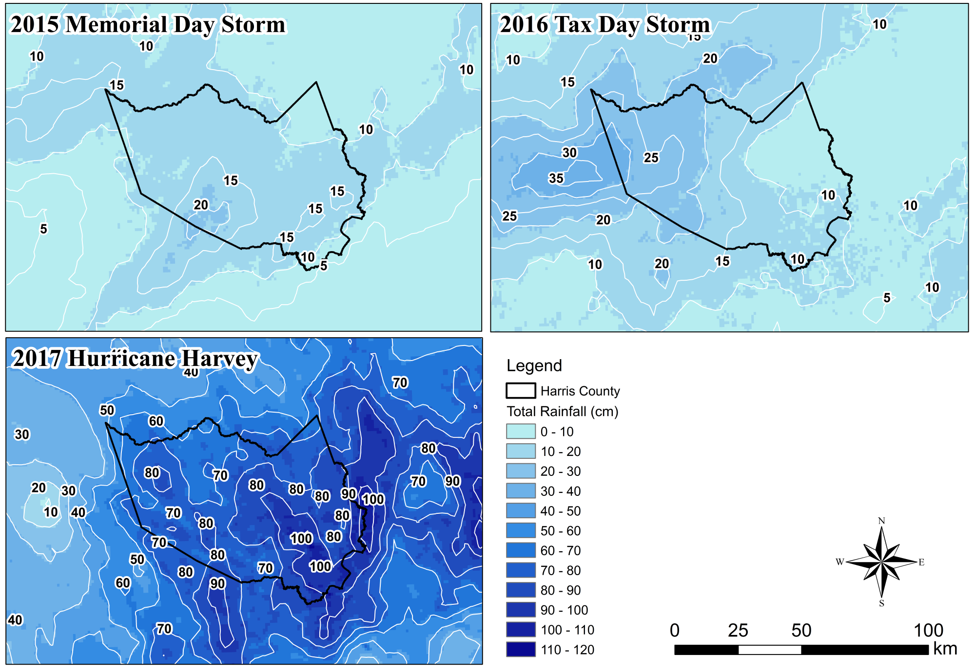
A)
B)
C)
Notes:
Figure 1. Total Precipitation of Three Storm Events over the Harris County

Slide 2
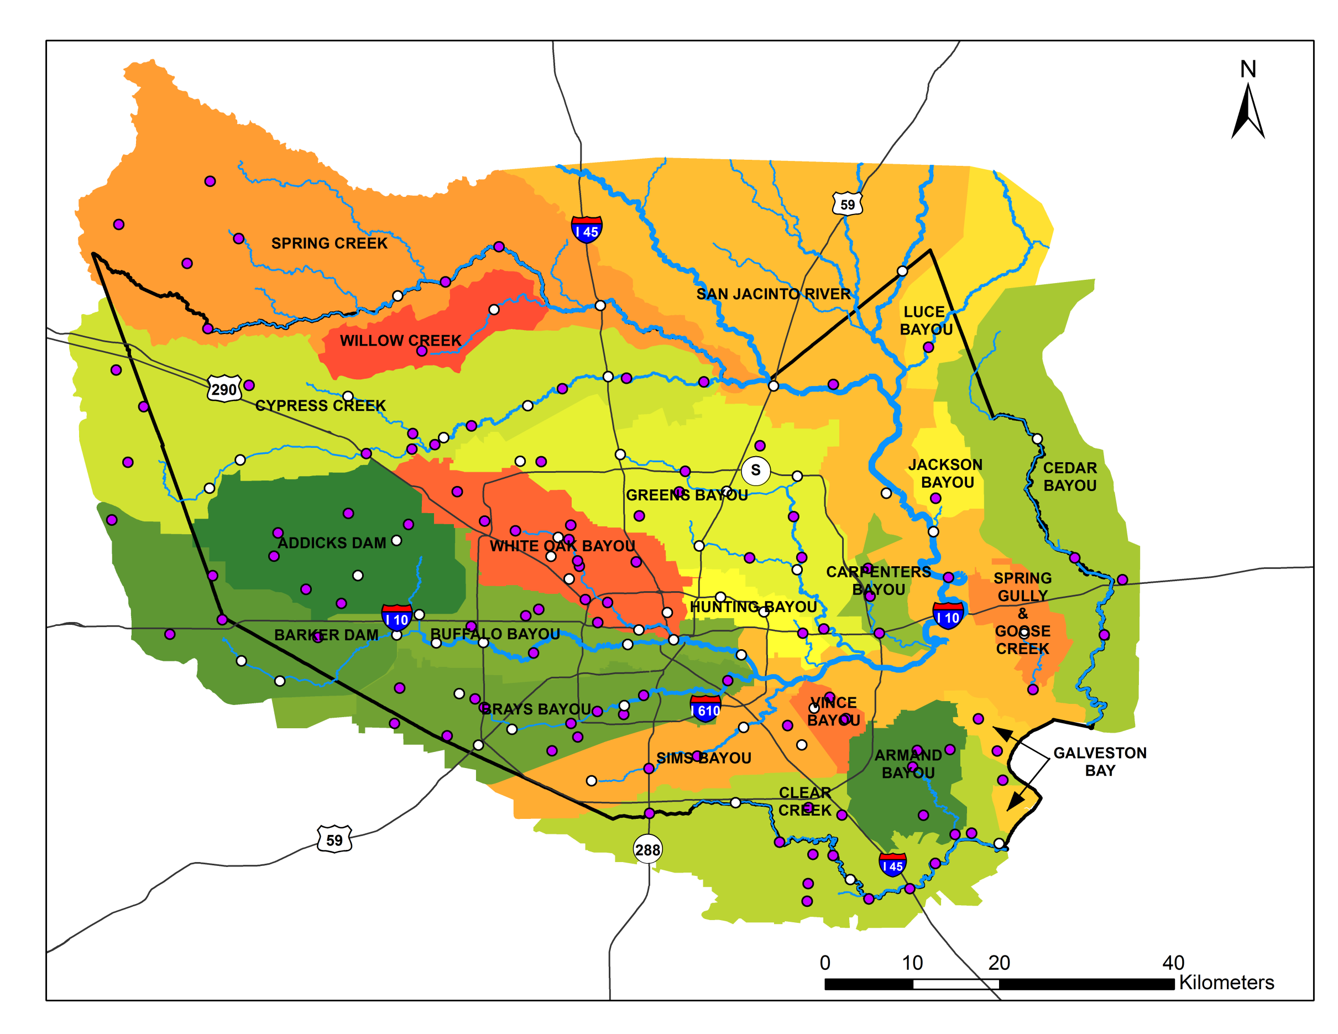
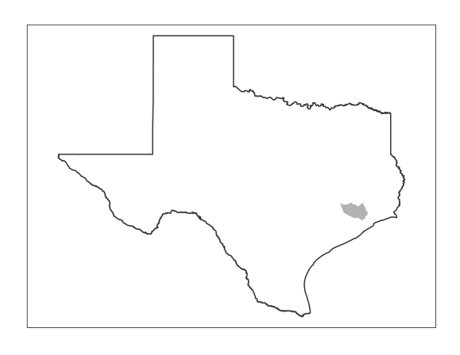
LEGEND
Flowline
Harris County
HCFCD Gauges
HADS Gauges
Texas
Harris County
Notes:
Figure 2. Study Area and the Rain Gauge Network

Slide 3
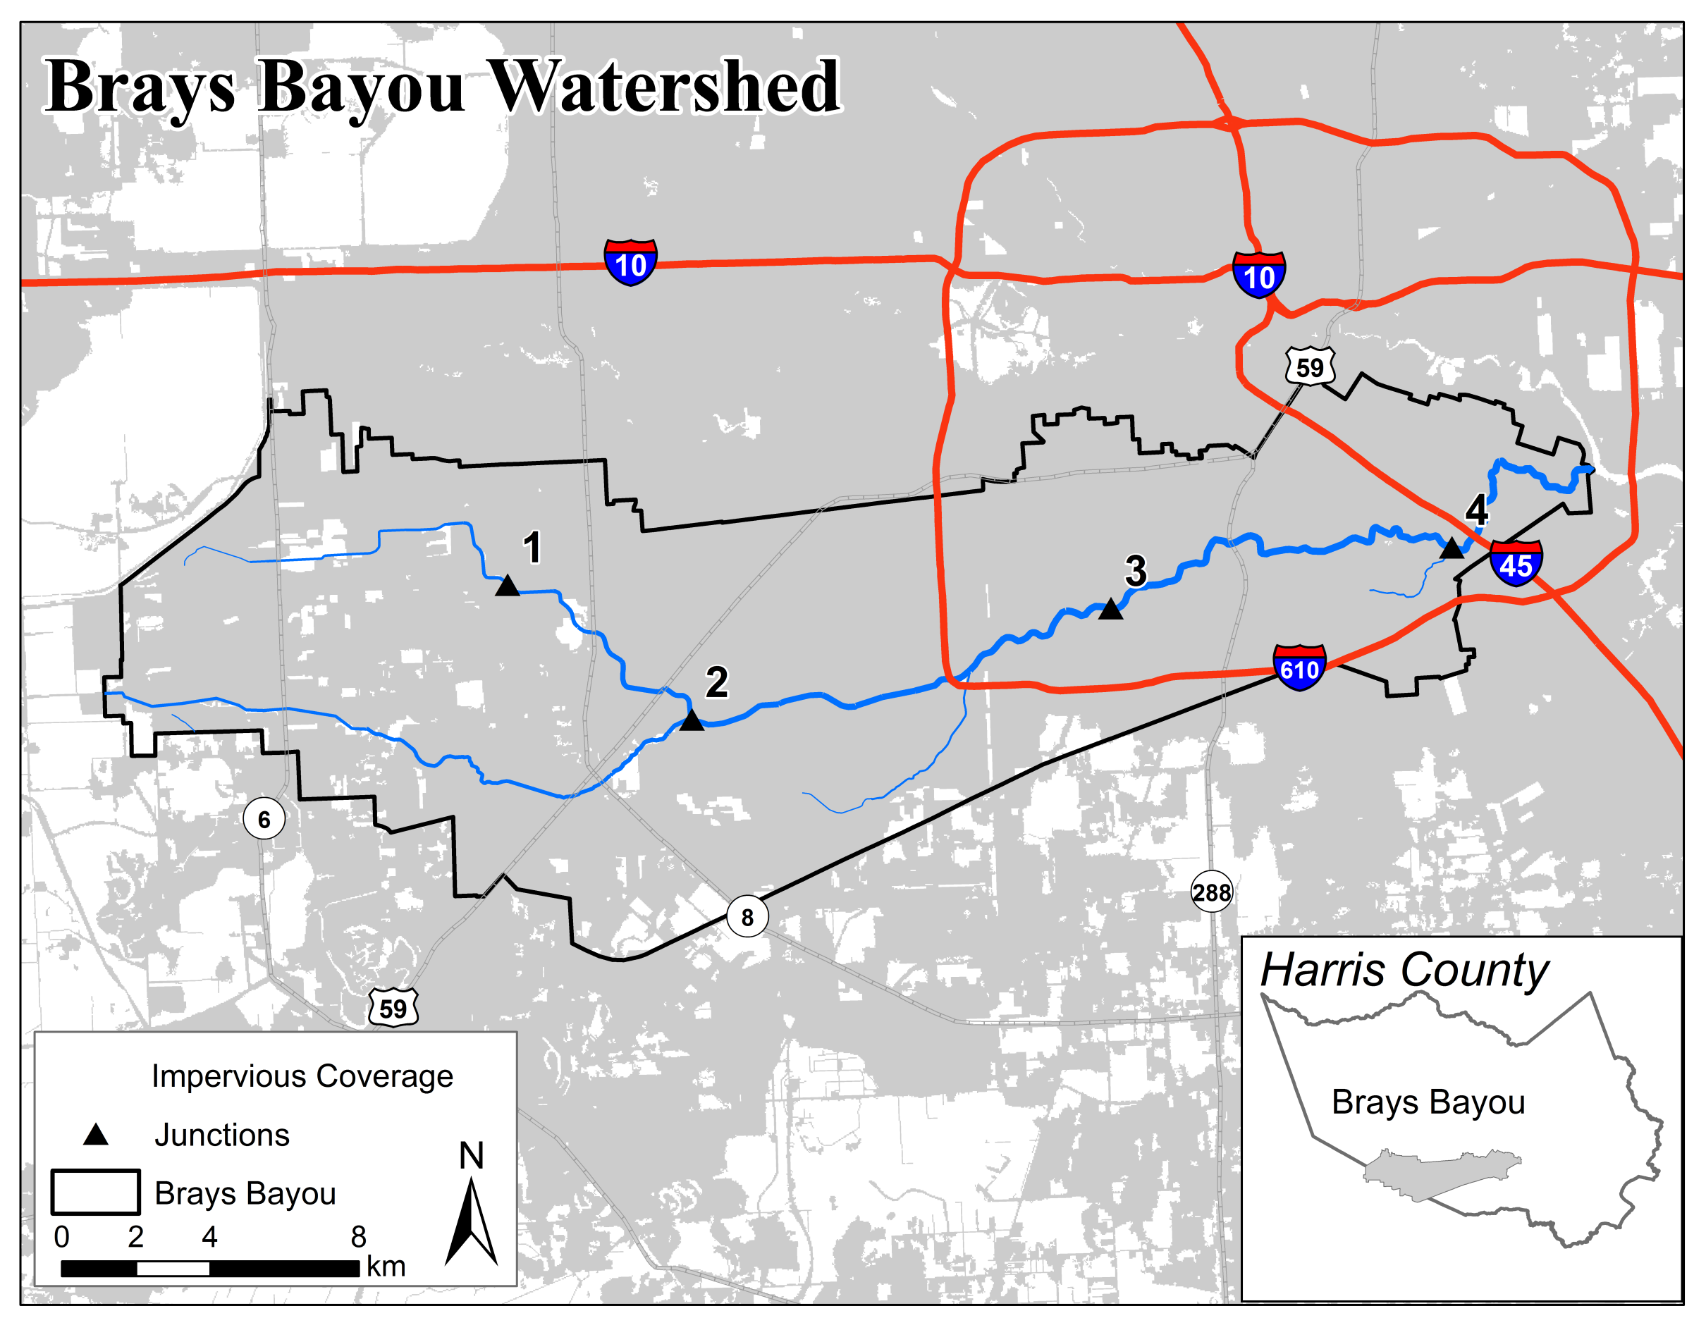
Notes:
Figure 3. Brays Bayou Watershed

Slide 4
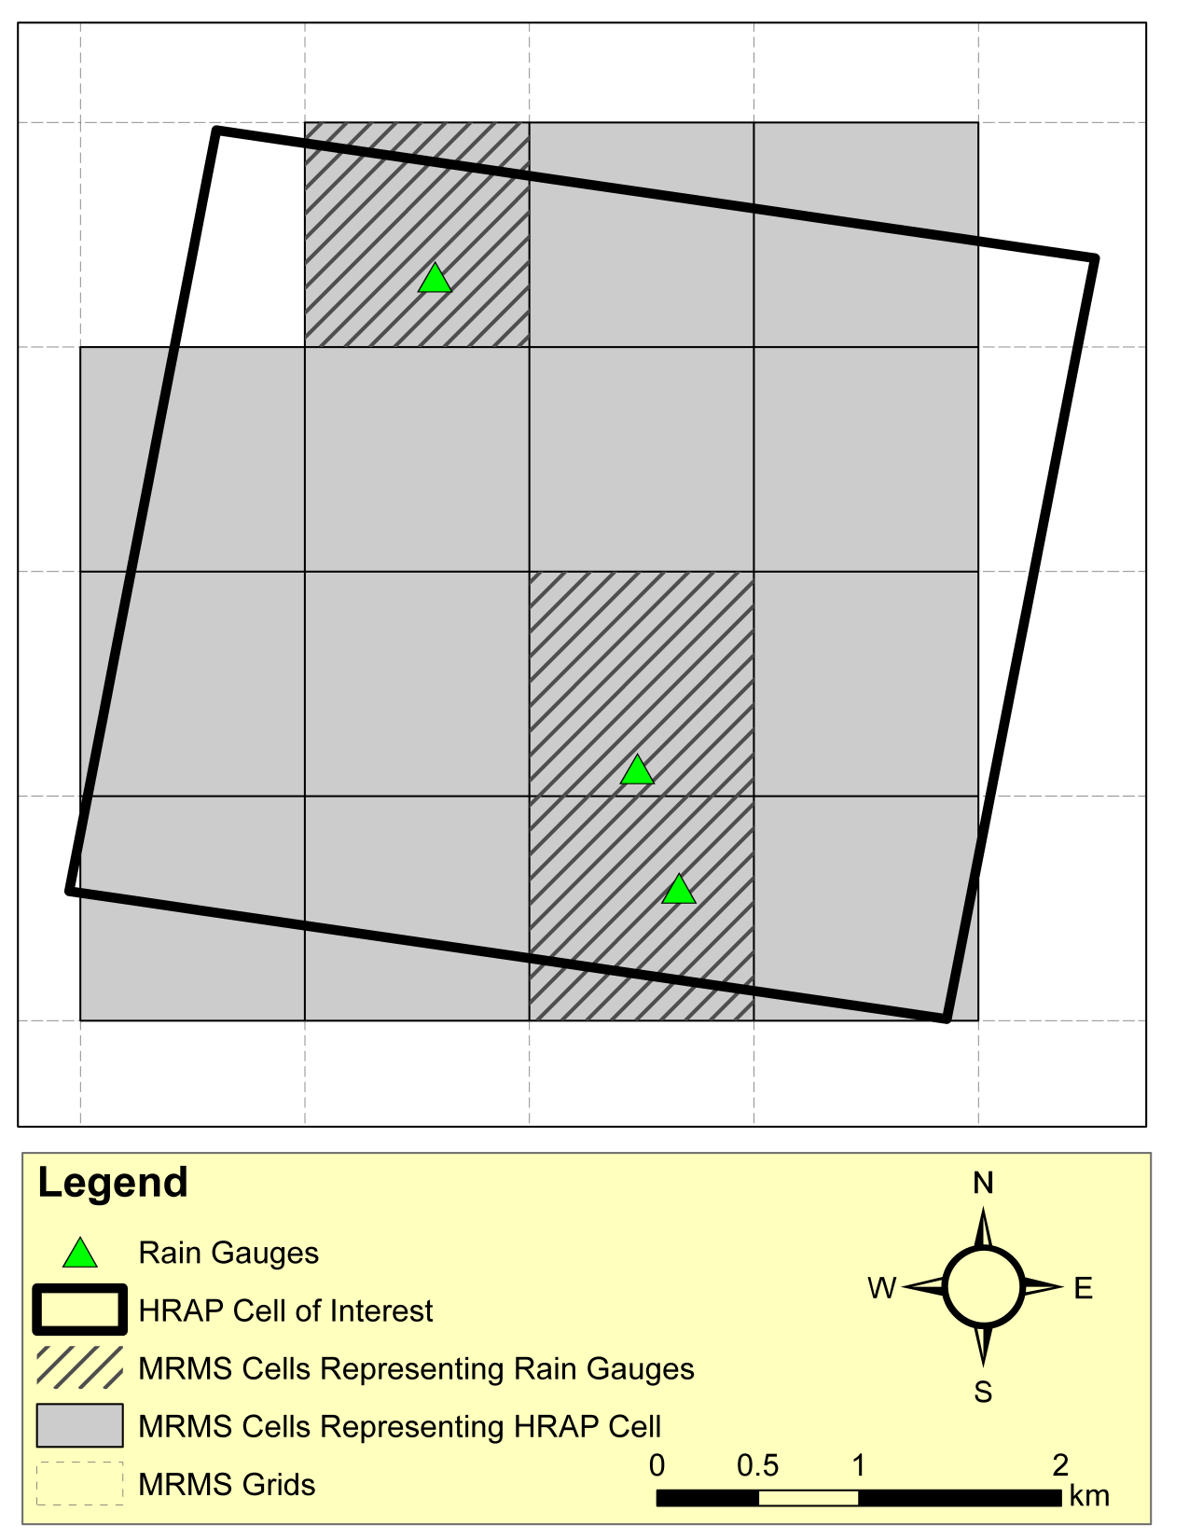
Notes:
Figure 4. Selection Scheme for Hourly Stage IV radar data

Slide 5
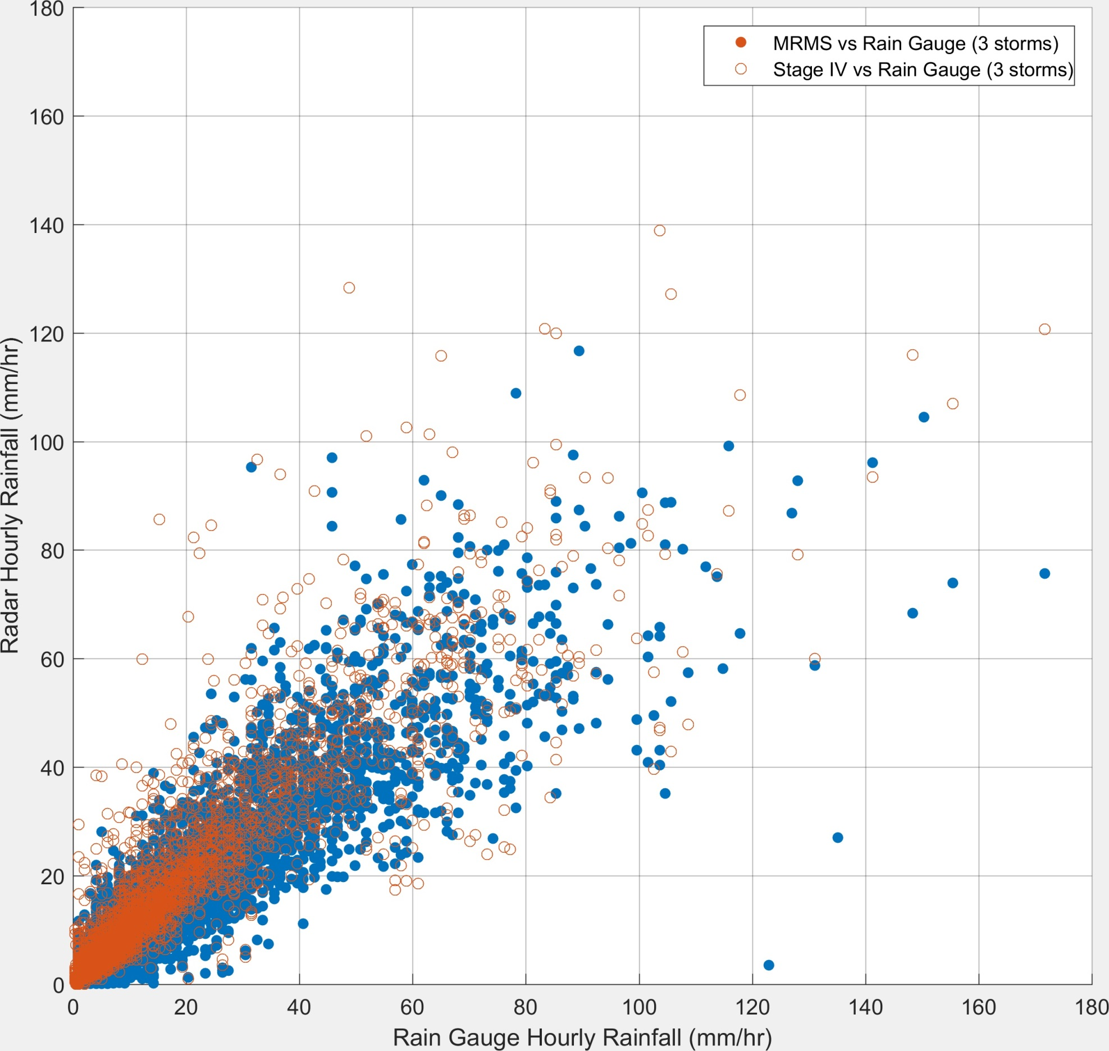
 | R² | RMSE | Sample Size
Stage IV | 0.812 | 0.293 | 4614
MRMS | 0.837 | 0.217 | 9934
Notes:
Figure 5. Scatter Plots of Stage IV and MRMS hourly QPE

Slide 6
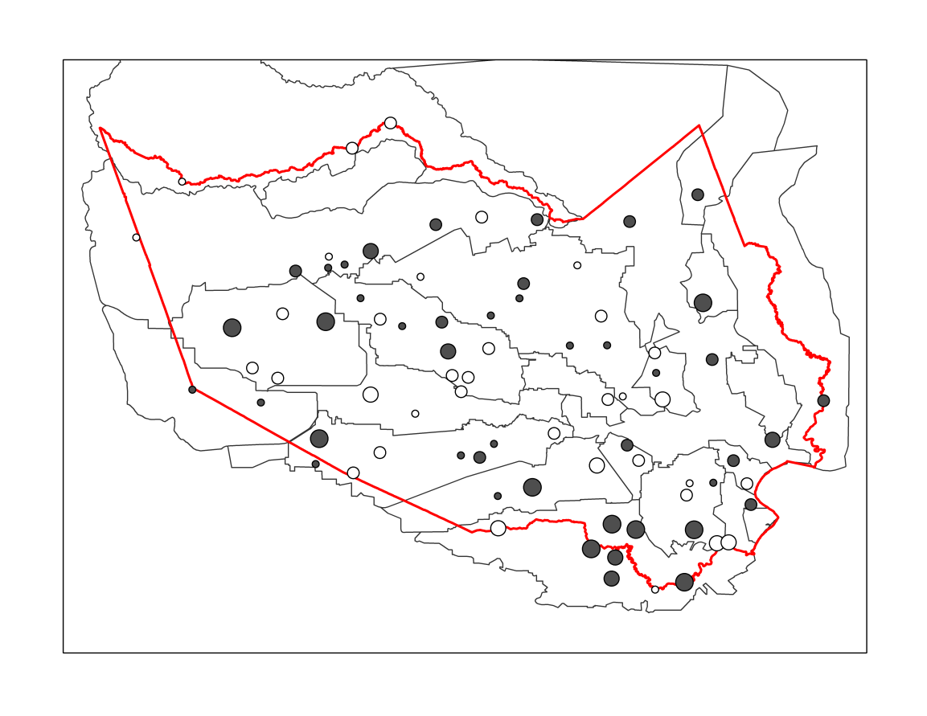
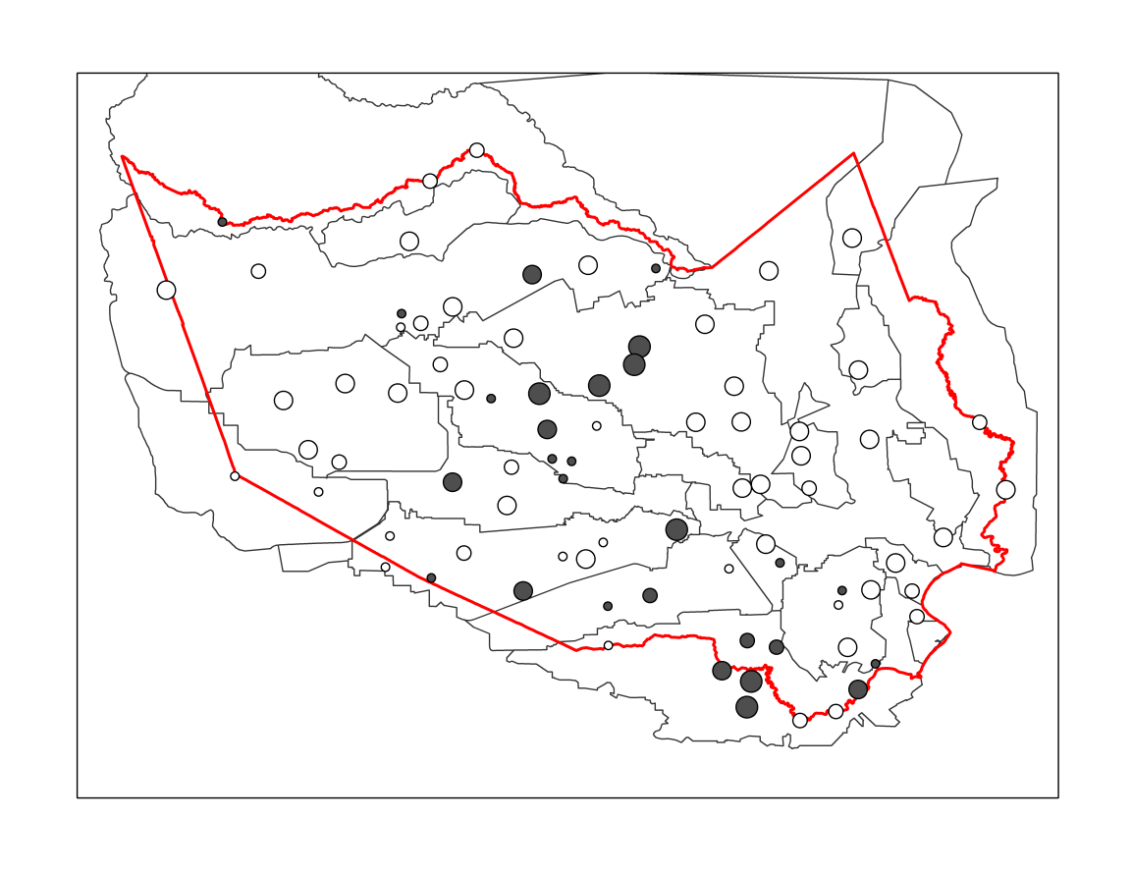
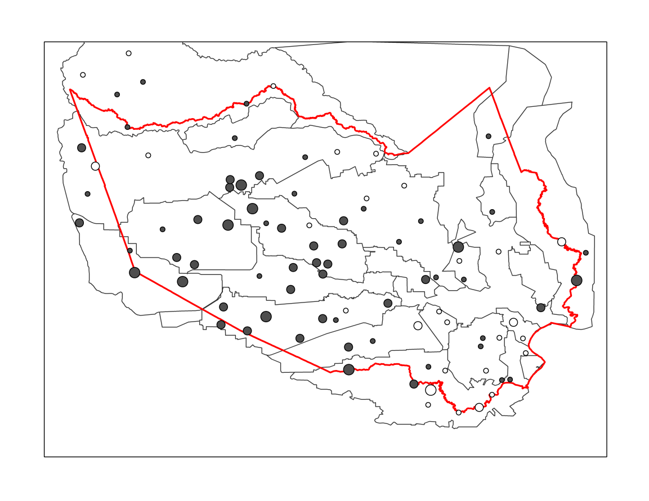
A)
B)
2015 Memorial Day Storm
2016 Tax Day Storm
C)
Harris County Boundary
Subwatersheds
Overall Bias
< 0.8
0.8 – 0.9
0.9 – 1.0
1.0 – 1.1
1.1 – 1.2
1.2 – 1.3
> 1.3
2017 Hurricane Harvey
Notes:
Figure 6. Overall Bias of Stage IV for Three Storm Events

Slide 7
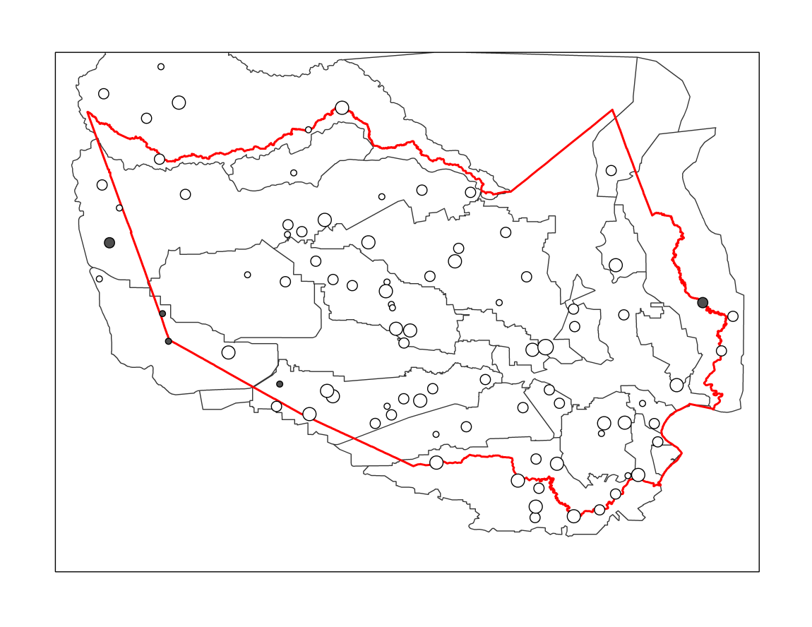
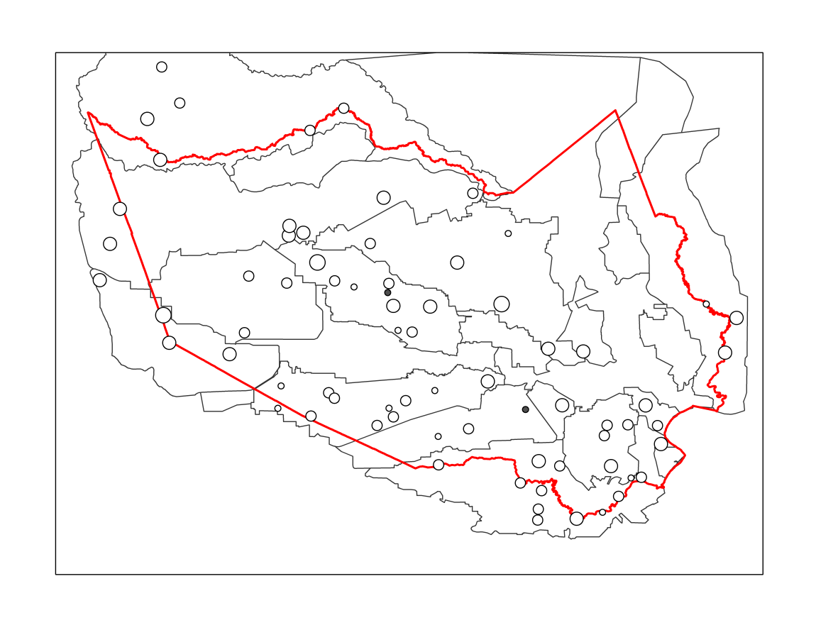
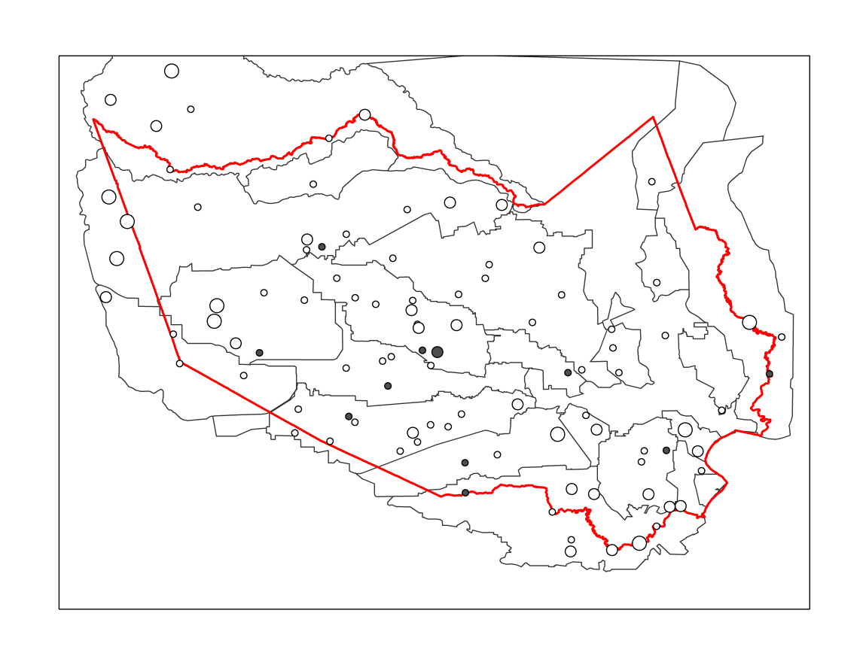
A)
B)
2015 Memorial Day Storm
2016 Tax Day Storm
C)
Harris County Boundary
Subwatersheds
Overall Bias
0.6 – 0.7
0.7 – 0.8
0.8 – 0.9
0.9 – 1.0
1.0 – 1.1
1.1 – 1.2
1.2 – 1.3
2017 Hurricane Harvey
Notes:
Figure 7. Overall Bias of MRMS for Three Storm Events

Slide 8
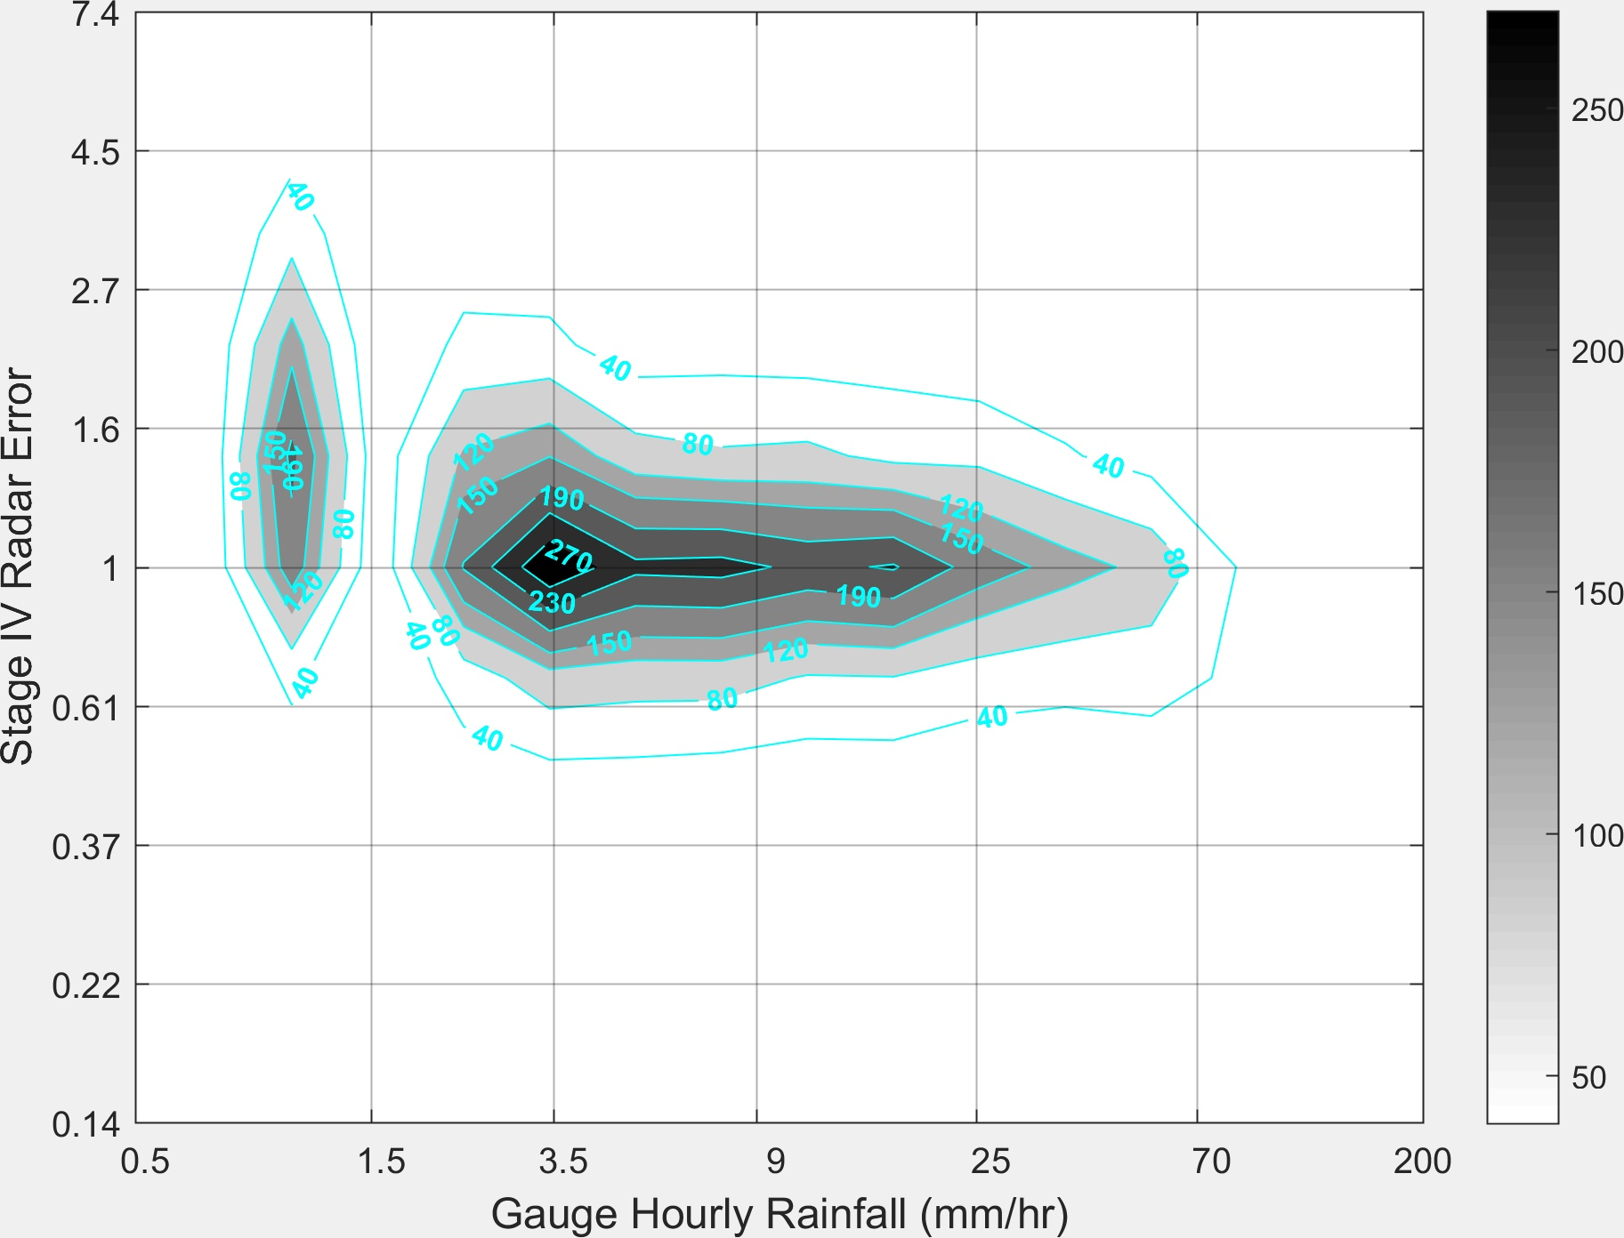
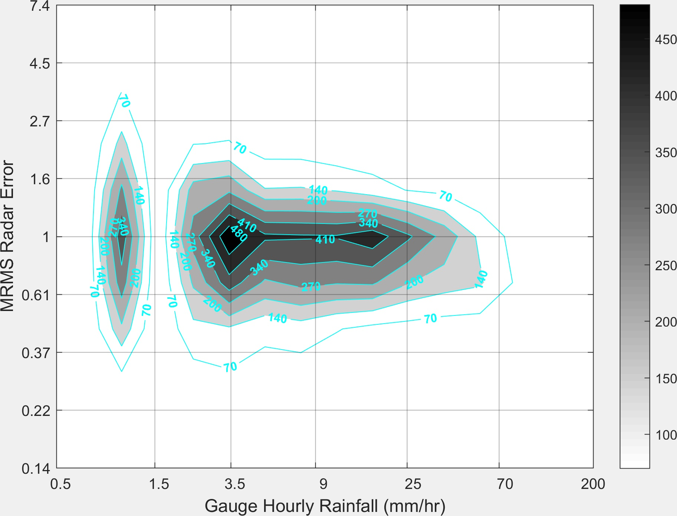
A)
B)
Notes:
Figure 8. 2-D Histogram of Radar Error for Three Storm Events

Slide 9
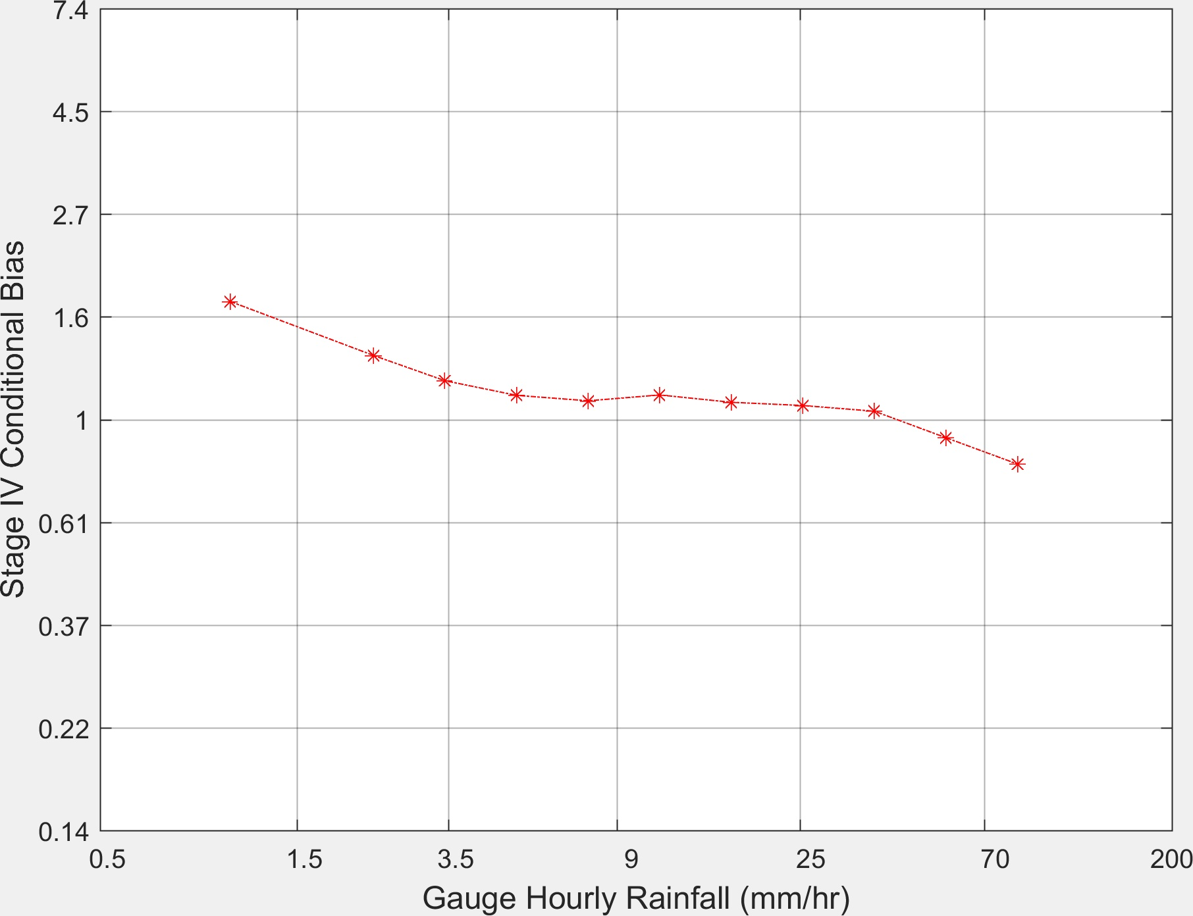
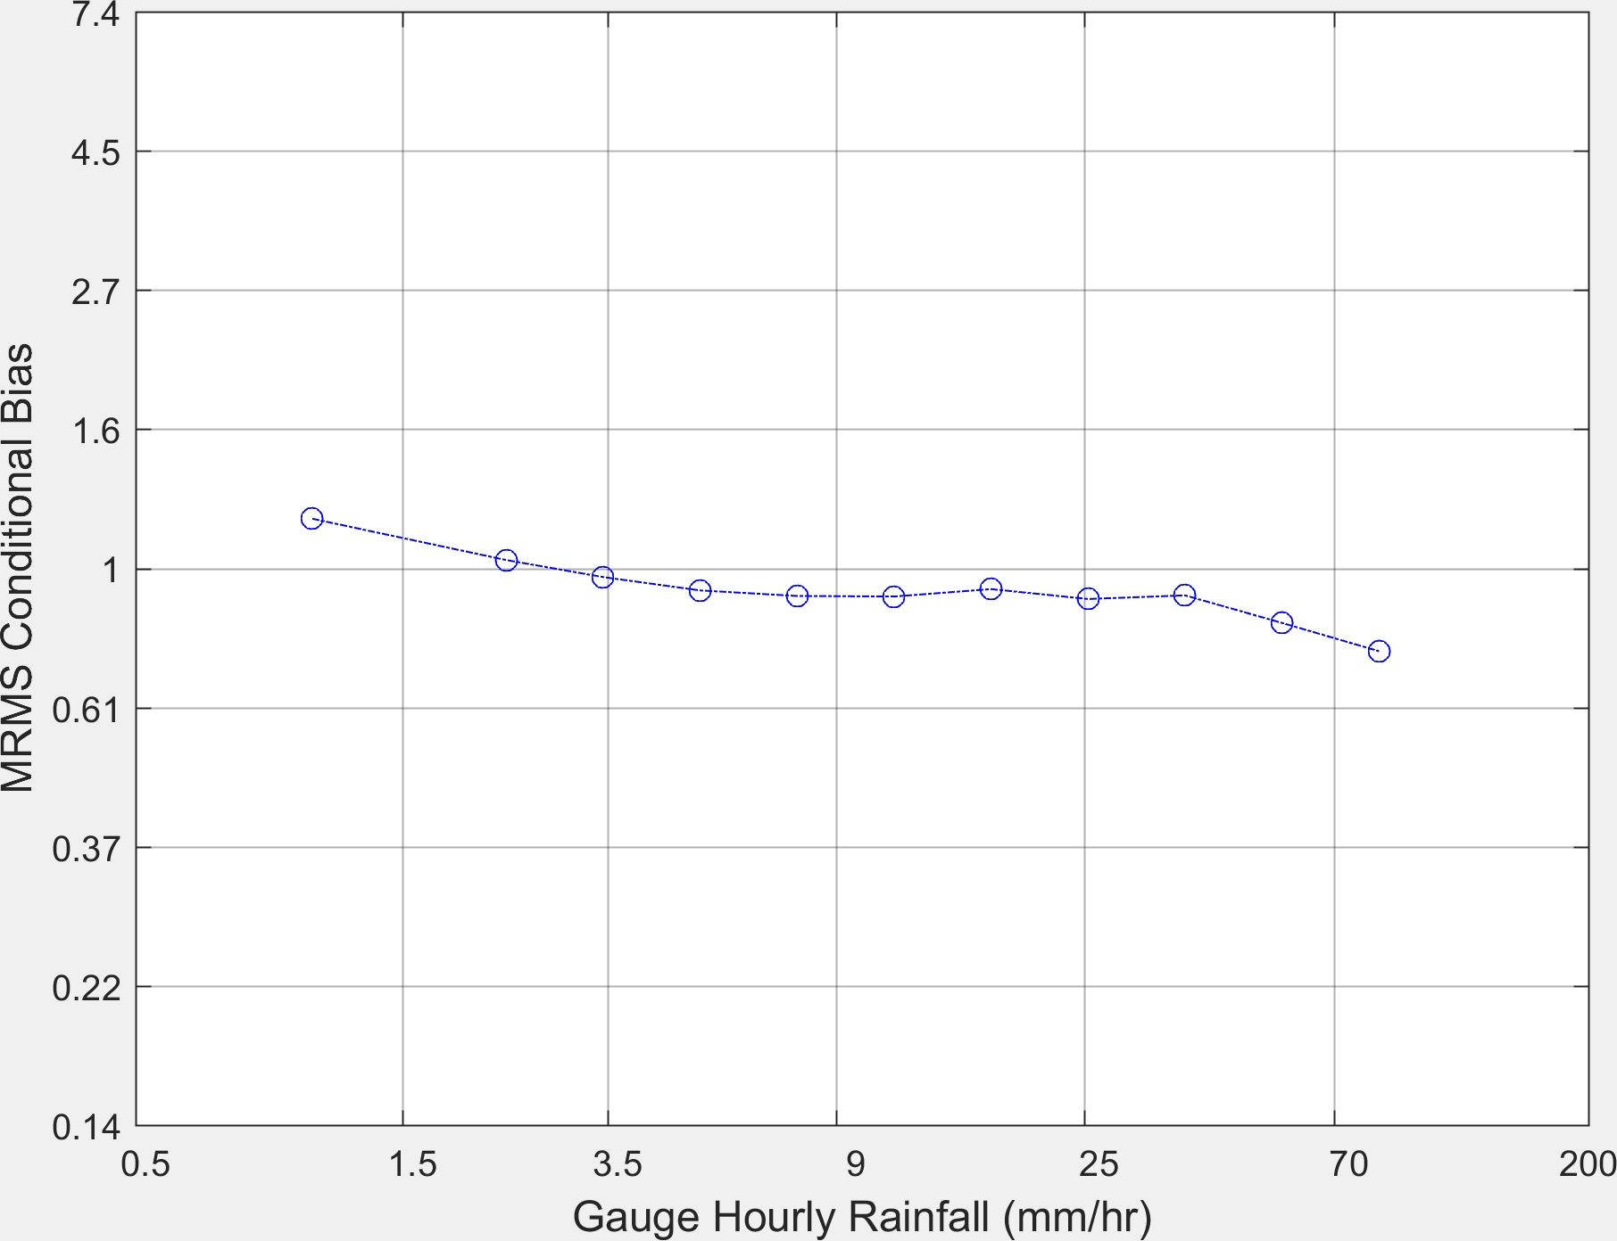
A)
B)
Notes:
Figure 9. Conditional Bias of Stage IV and MRMS

Slide 10
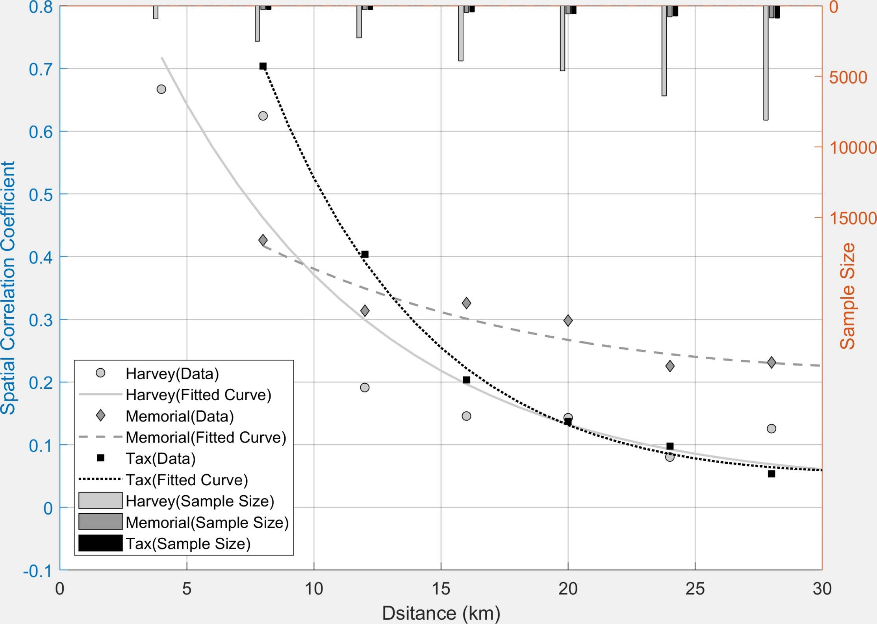
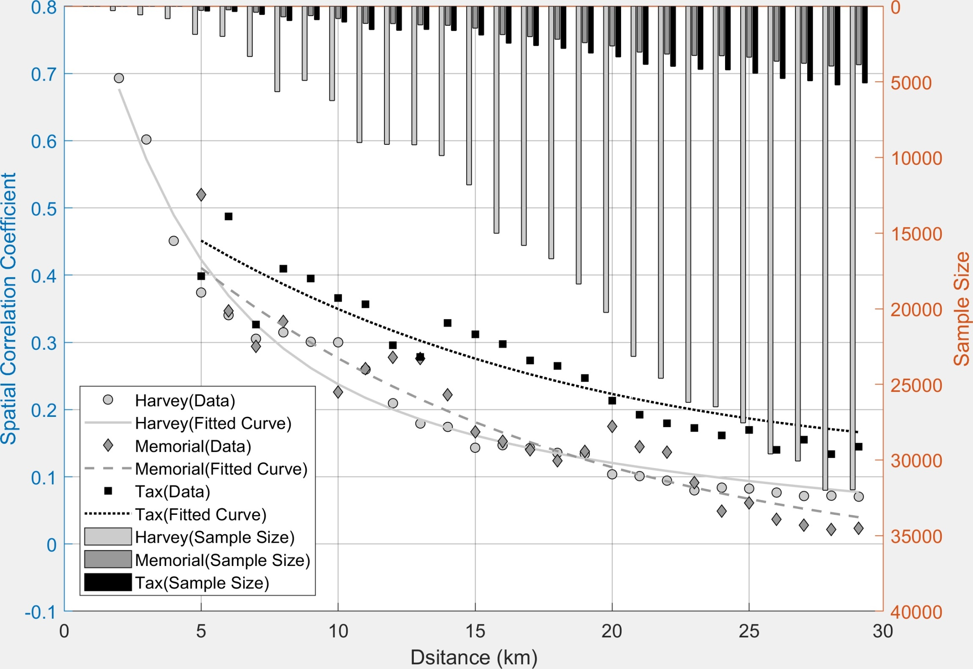
A)
Distance (km)
B)
Distance (km)
Notes:
Figure 10. Spatial Autocorrelation Coefficients of Stage IV and MRMS Radar Errors for Three Storm Events

Slide 11
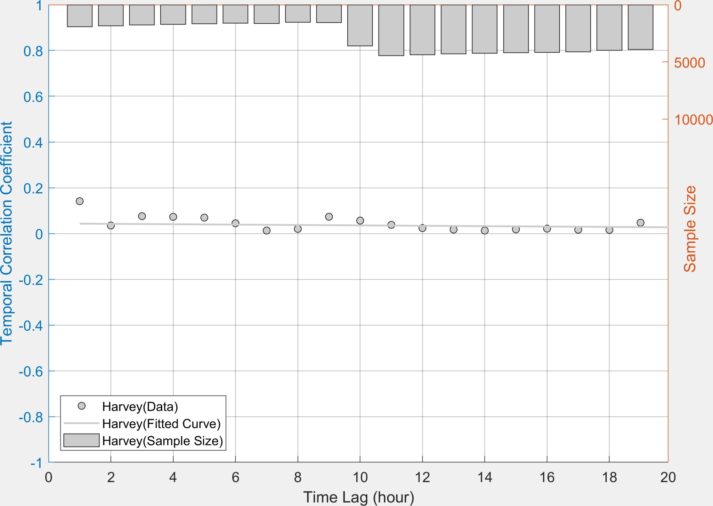
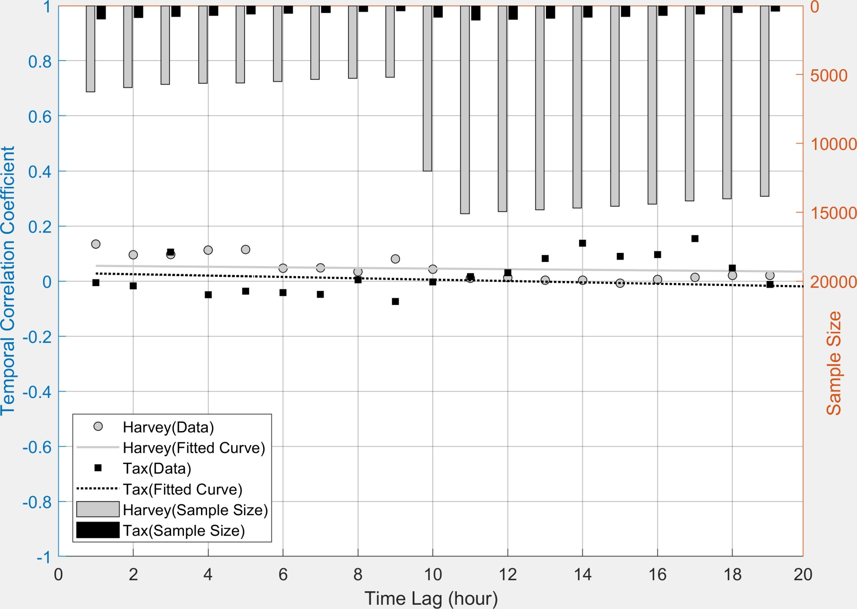
A)
B)
Notes:
Figure 11. Temporal Autocorrelation Coefficients of Stage IV and MRMS Radar Errors for Three Storm Events

Slide 12
A)
B)
C)
D)
Notes:
Figure 12. Simulated and Observed Hydrographs for Harvey at Four Junctions in Brays Bayou Watershed

